Slide 1
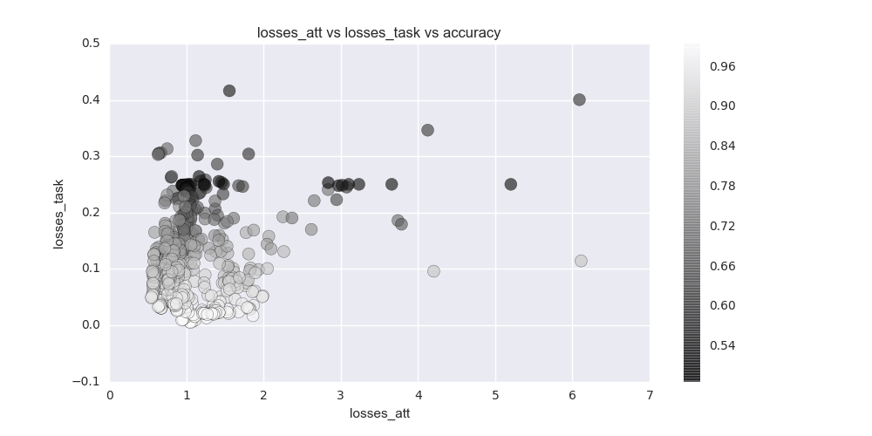
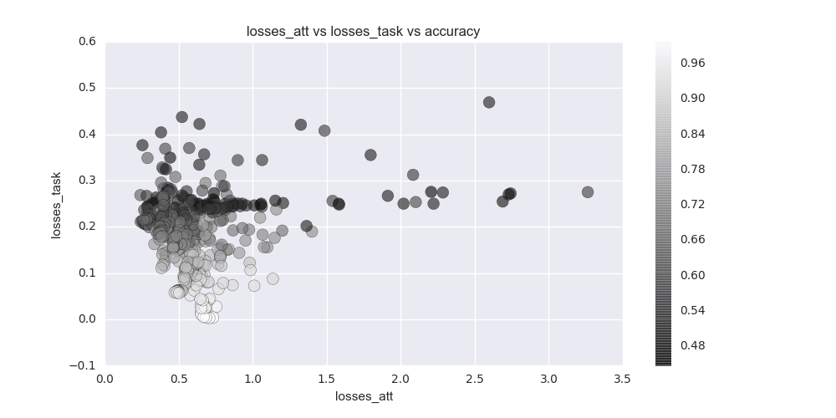
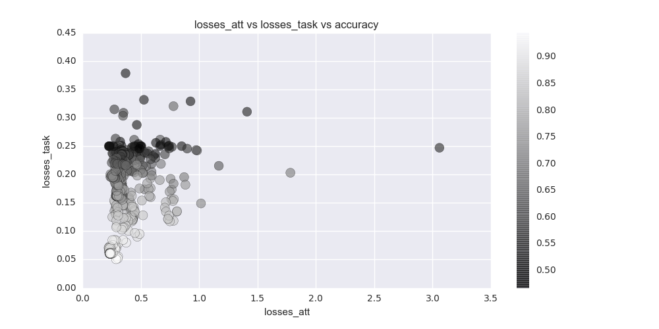
Consistent across various noise settings
0.1
0.2
0.3

Slide 2
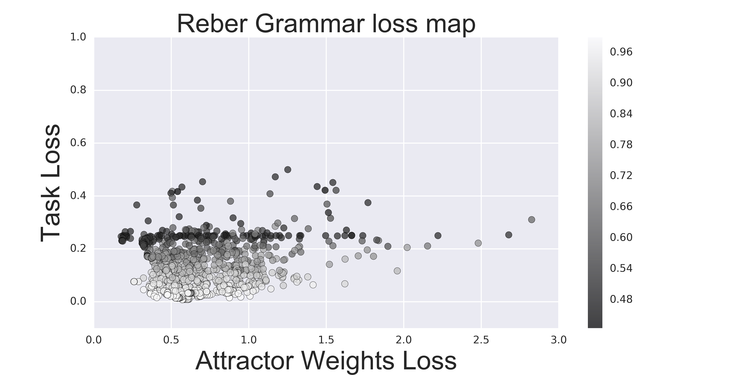
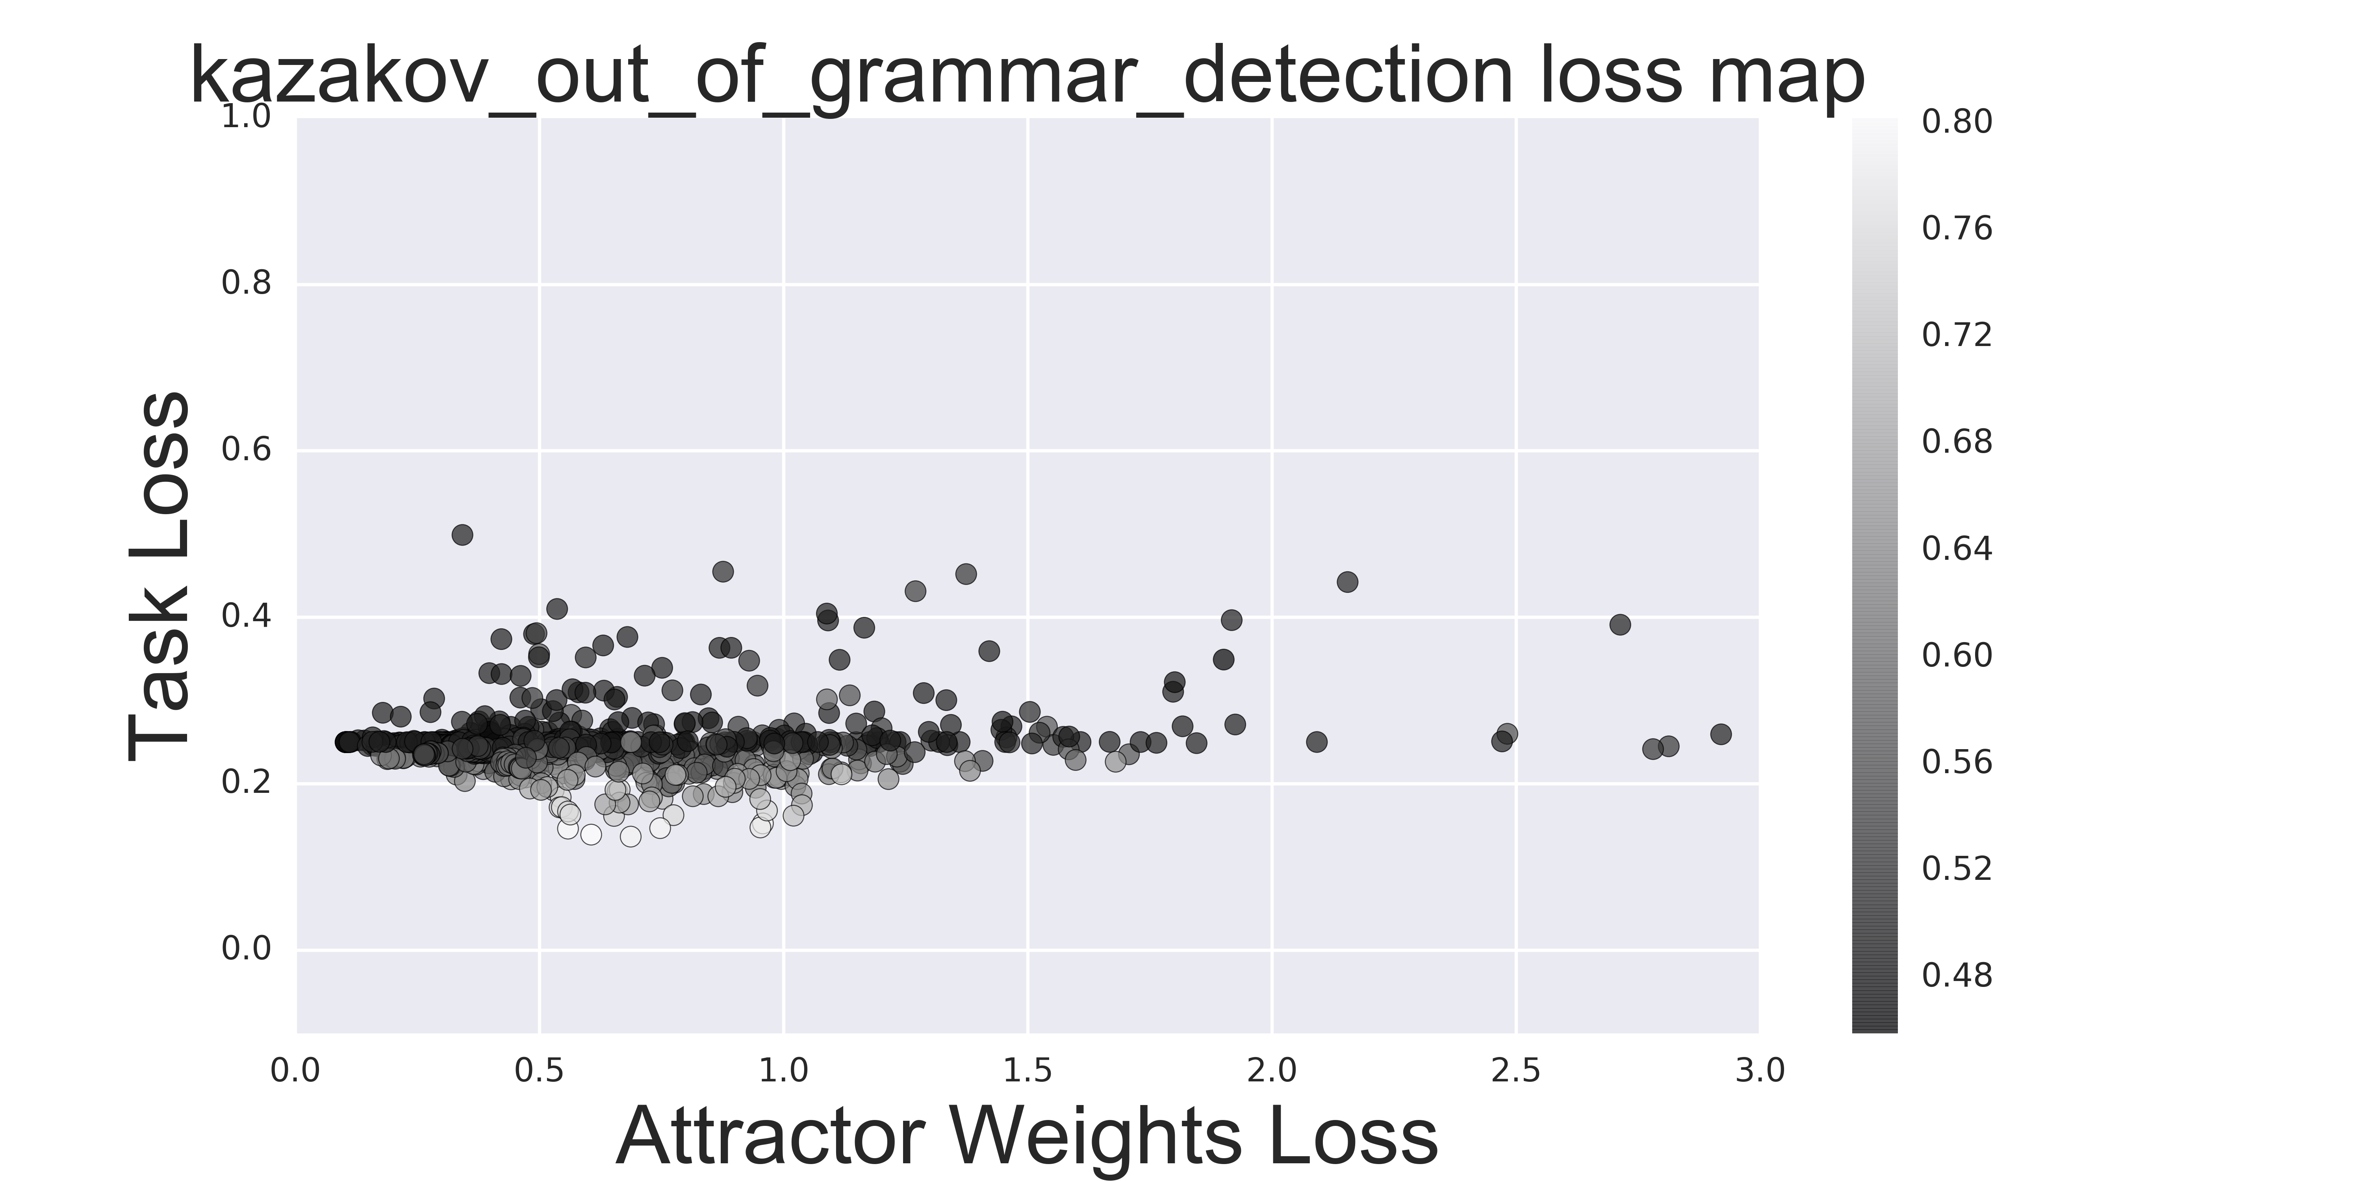
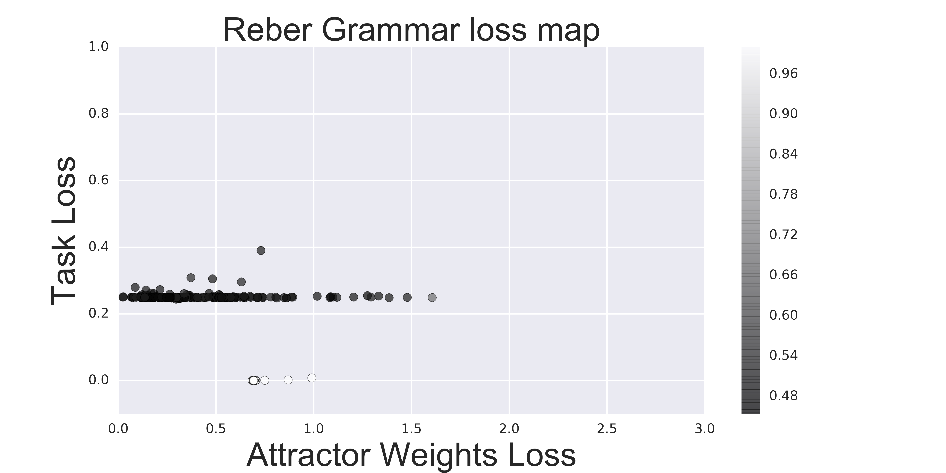
Same equilibrium location on different tasks
reber
kazakov
xor

Slide 3
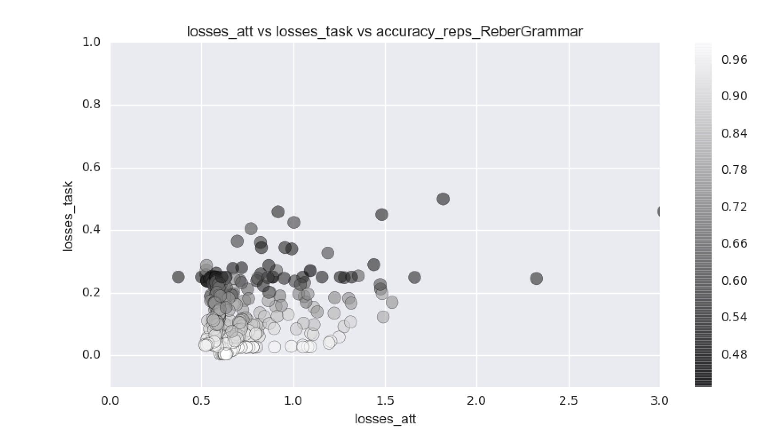
Limiting the attractor loss value (0.2=:lambda)
Not limiting
Limiting
(measure if this actually does better) stopping one training works against the task loss

Slide 4
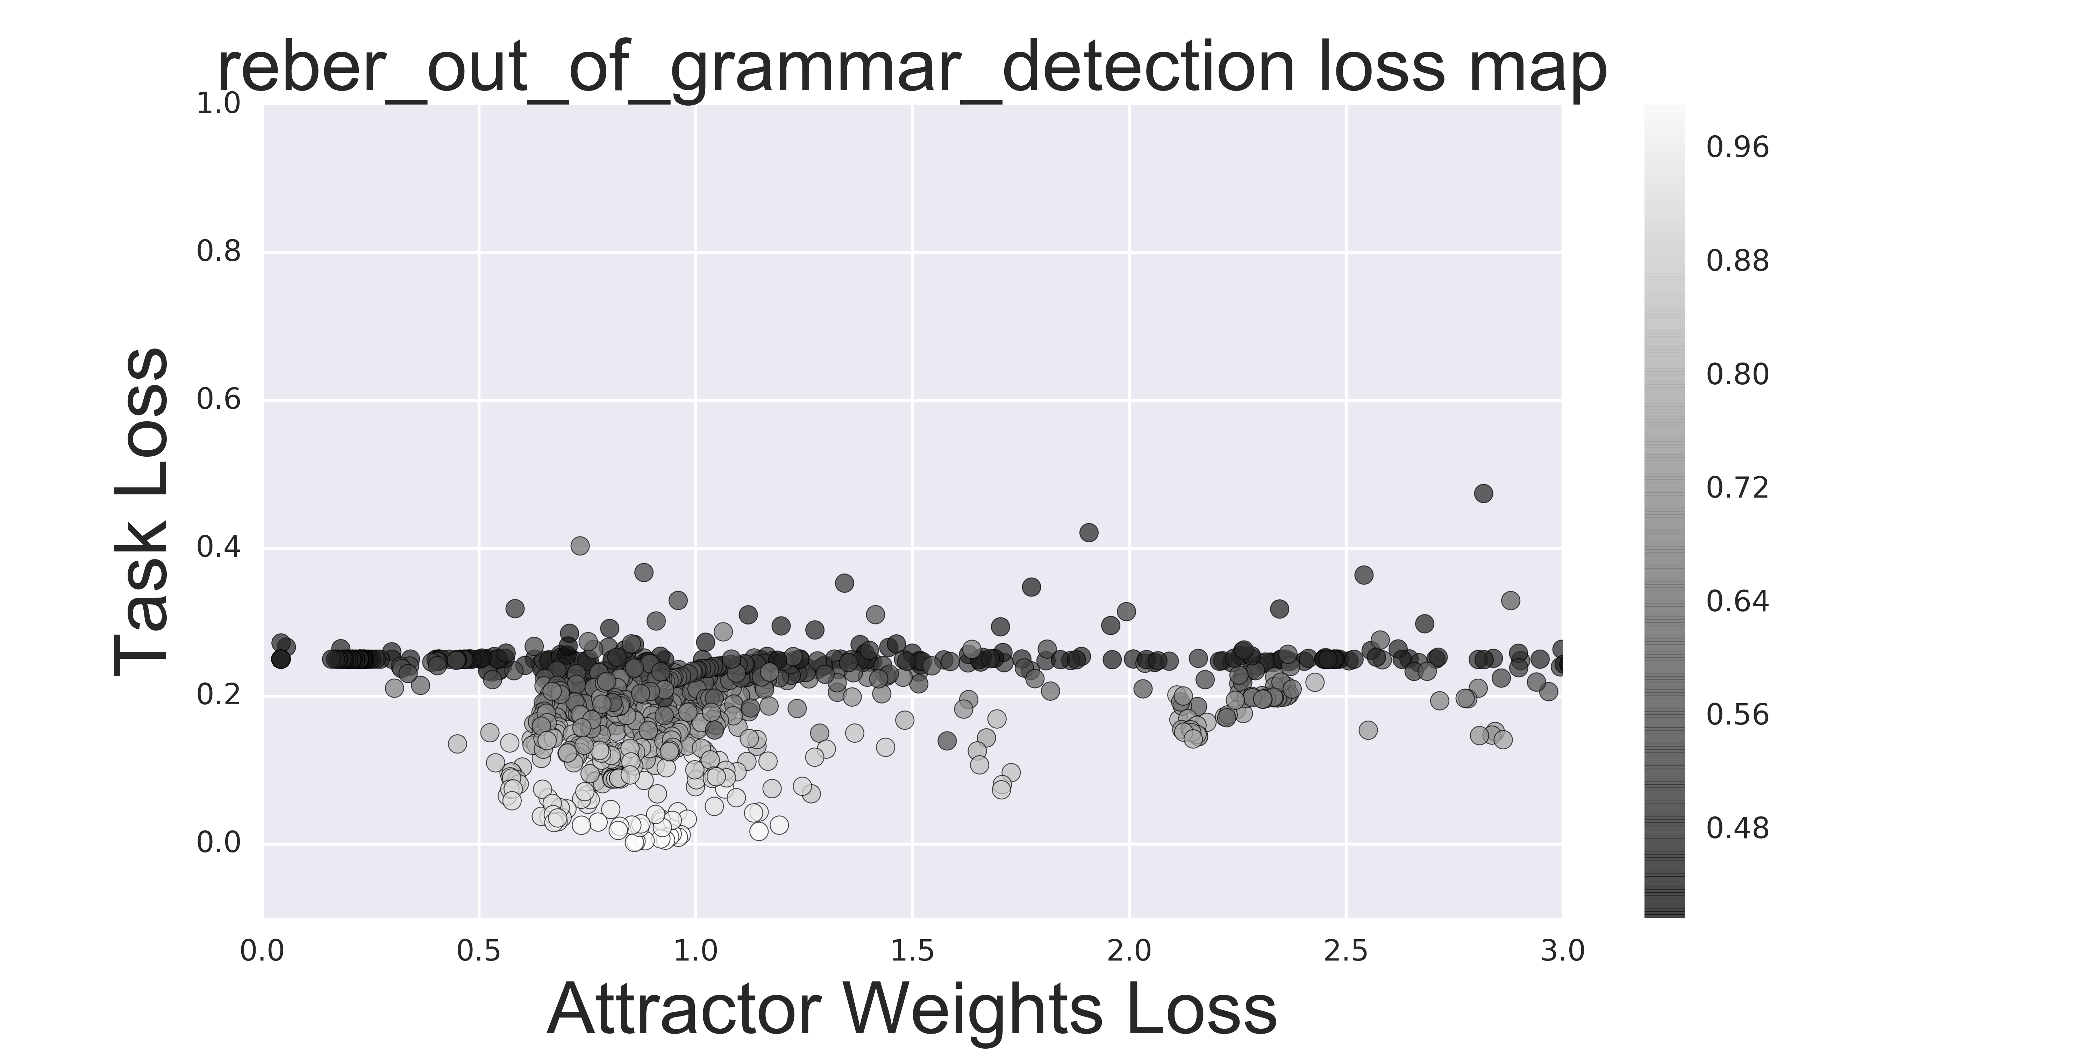
Architecture tweaks (HH, lambda 0.1)
HH – not super stable, but it’s not optimized currently for convergence, so convergence is mostly due to training objective

Slide 5
Architecture tweaks (separate projection)
Not sure how to incentivize them to cooperate while training separately
Maybe this is where some information sensitive incentive might be helpful. This idea feels right since the two tasks are really separate, so forcing them to work in the same domain seems restrictive.

Slide 6
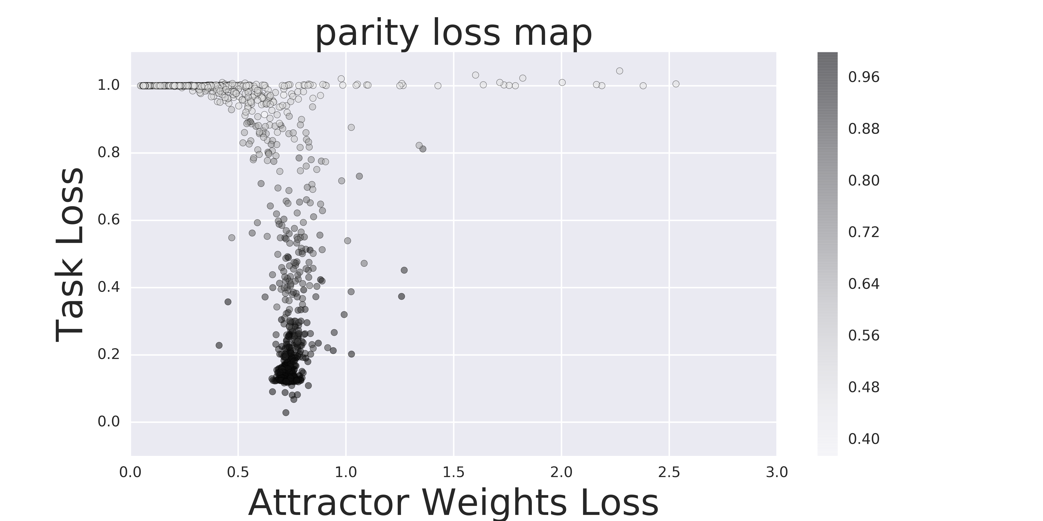
What to look for
Failed (attractor converged without communicating with the task objective)
Success (attractor converged while communicating with the task objective => some sort of equilibrium in attraction reached)
QUETSION: should we incentivize the communication stronger somehow? Sometimes the bias_lambda gets small, but maybe force the network to pay attention to input_bias

Slide 7
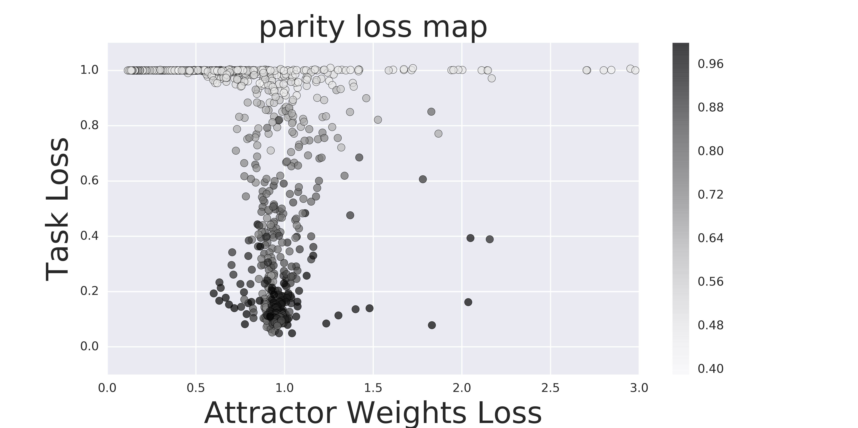
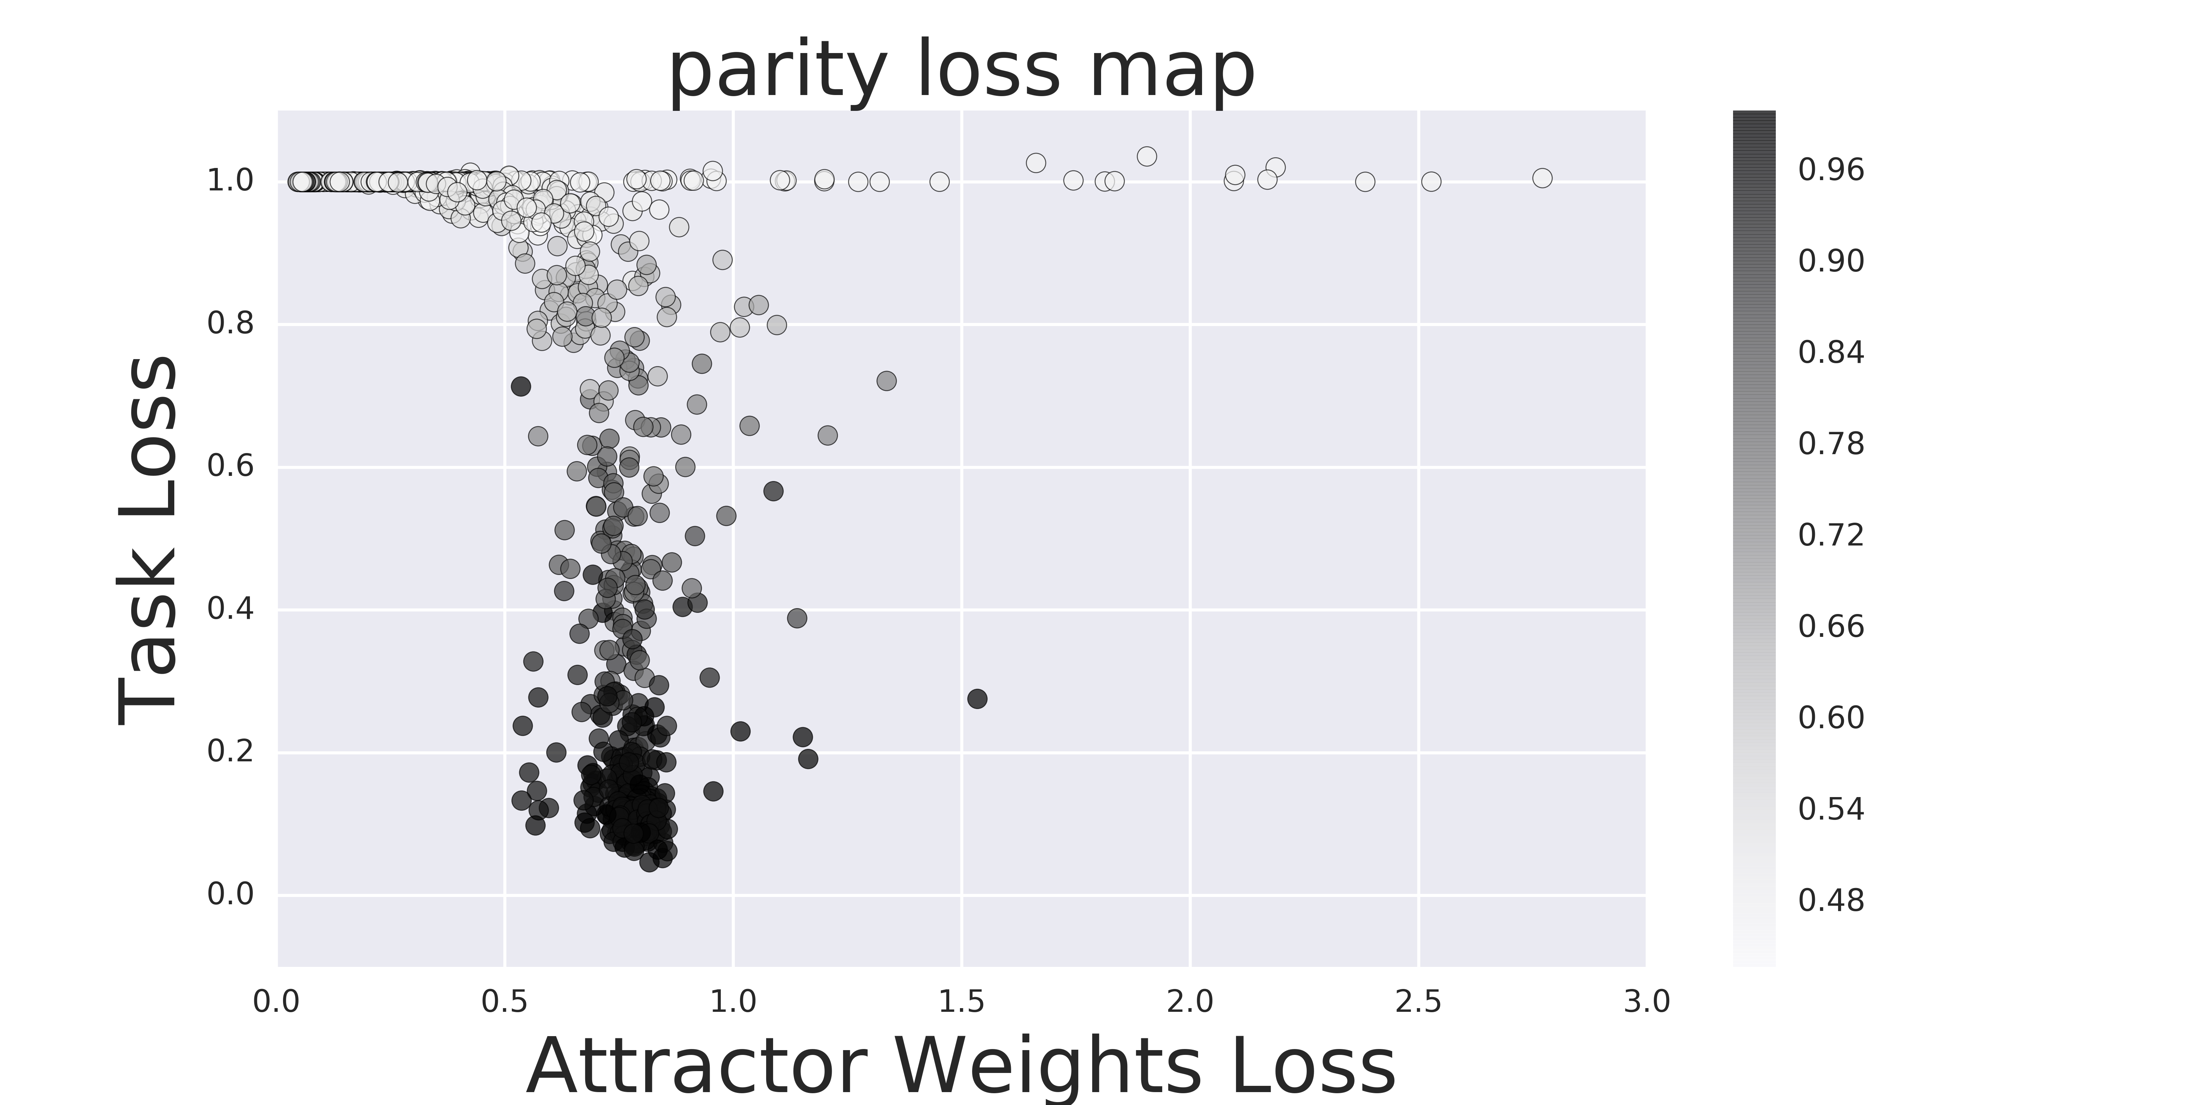
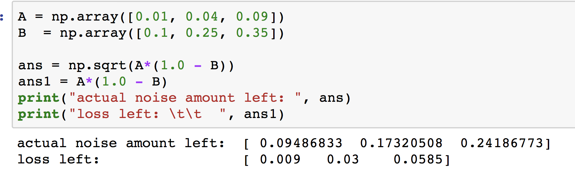
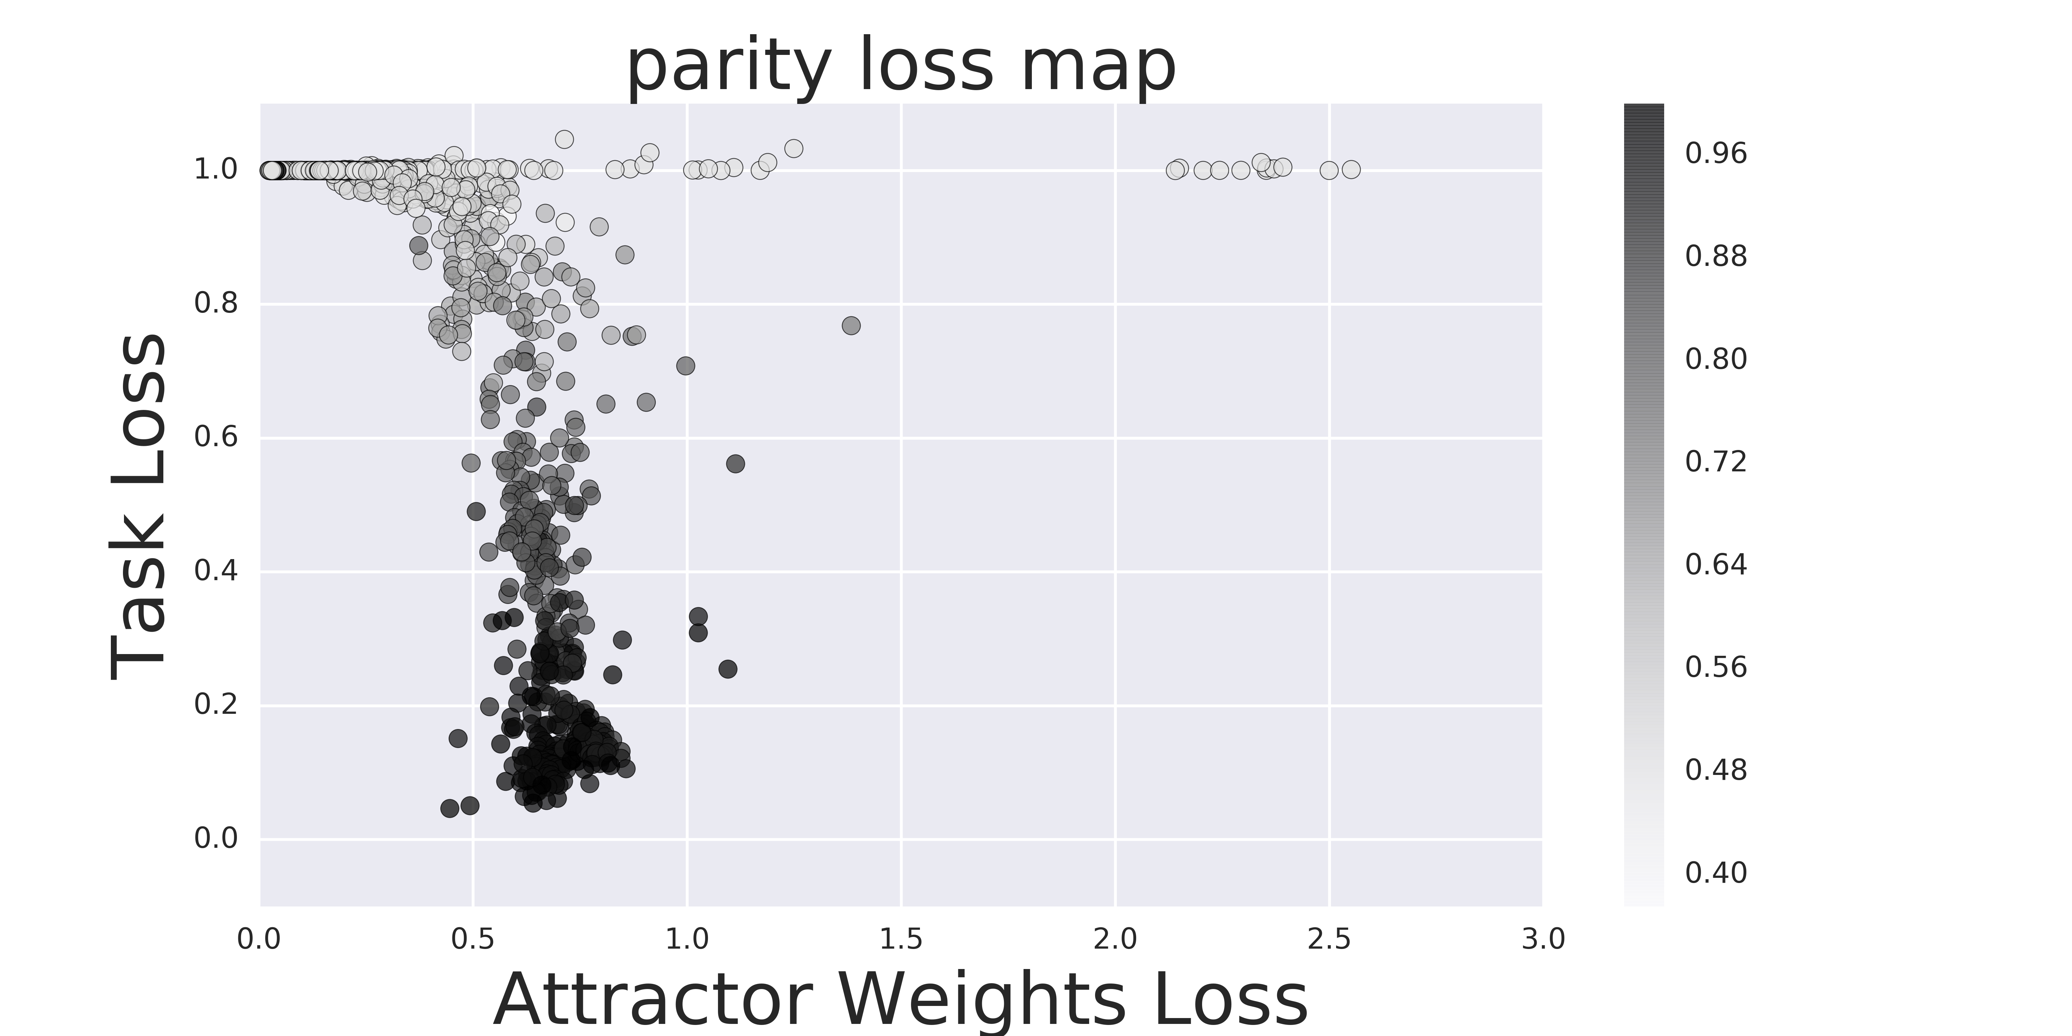
Equilibrium of “attraction” (“direct” attractor)
Noise added: 0.1*Normal_Distribution_Sample
Noise added: 0.2*Normal_Distribution_Sample
Noise added: 0.3*Normal_Distribution_Sample
The more noise we add, the more we shift the equilibrium. However if we computer how much original noise (value, not %) is left. It’s approximately: ((lambda^2*(1.0 – (1 – where_star_is)))^(1/2)
Lambda^2 – A
Where_star_is – B
QUESTION: So the system gets noisier. Why does it decide that it can operate under different noise amounts as its “optimum”?

Slide 8
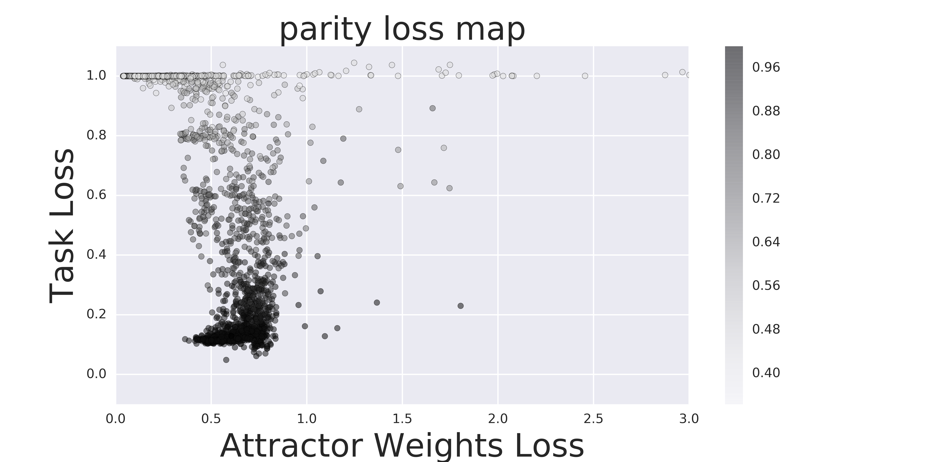
hidden-hidden. We map to the same number of HH, but HH seem to steer more left than “direct” attractor. + more spread out => likely less tied to specific value due to a different problem space.
(2018-02-20)[Model<GRU>(attractor<direct,hid(5),h_hid(5)>, noise<0.2>, n_iterations<5>), Problem<parity>][epochs<5000>, repetitions<30>]__[MIKES CODE],solved[24of30]
(2018-02-20)[Model<GRU>(attractor<projection,hid(5),h_hid(5)>, noise<0.2>, n_iterations<5>), Problem<parity>][epochs<5000>, repetitions<30>]__[MIKES CODE],solved[20of30]
QUESTION: so what? Is this even useful?

Slide 9
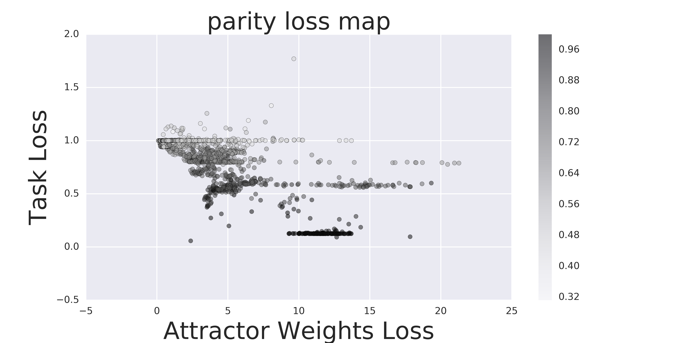
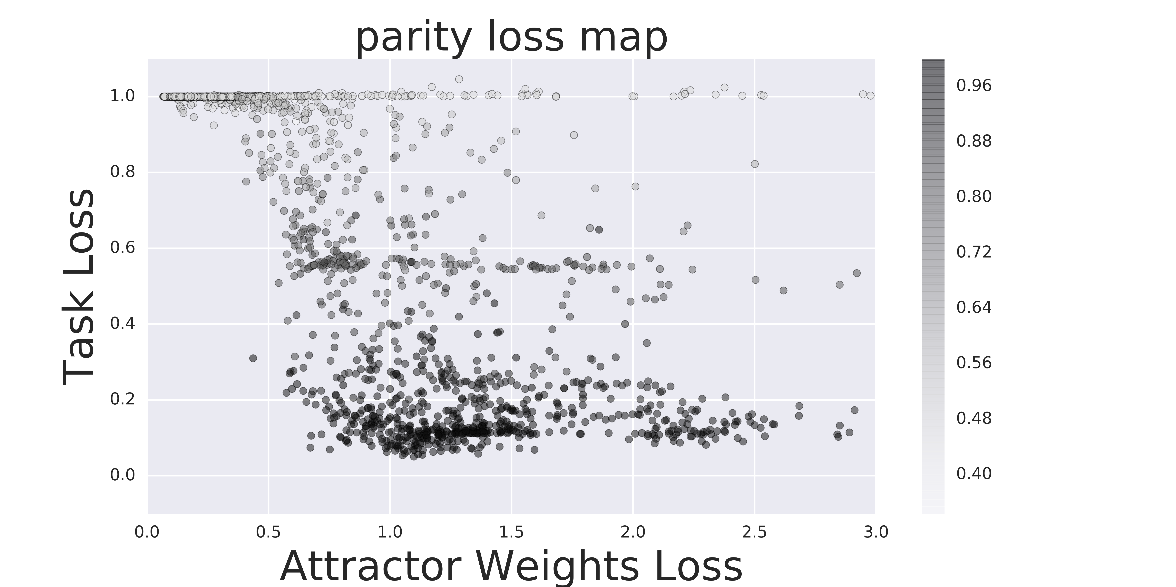
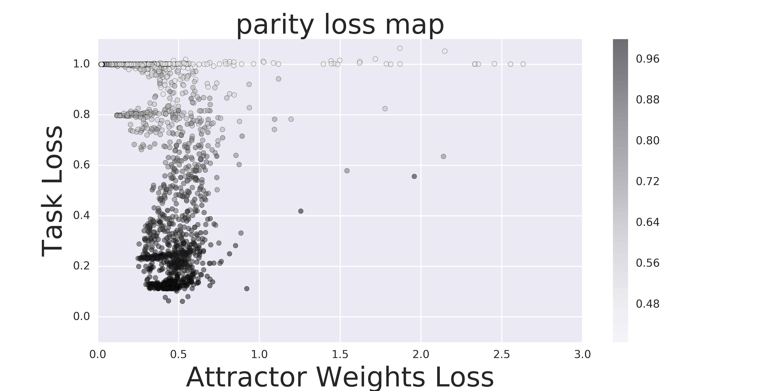
Projection (more h_hid removes more noise, but around the same performance) + confusing loss question
(2018-02-20)[Model<GRU>(attractor<projection,hid(5),h_hid(1)>, noise<0.2>, n_iterations<5>), Problem<parity>][epochs<5000>, repetitions<30>]__[MIKES CODE],solved[9of30]
(2018-02-20)[Model<GRU>(attractor<projection,hid(5),h_hid(3)>, noise<0.2>, n_iterations<5>), Problem<parity>][epochs<5000>, repetitions<30>]__[MIKES CODE],solved[22of30]
QUESTION: how come that even though we are essentially creating more noise (att_loss > 1.0), the network still learns to work with this. What exactly does it learn then?
(2018-02-20)[Model<GRU>(attractor<projection,hid(5),h_hid(5)>, noise<0.2>, n_iterations<5>), Problem<parity>][epochs<5000>, repetitions<30>]__[MIKES CODE],solved[20of30]
(2018-02-20)[Model<GRU>(attractor<projection,hid(5),h_hid(10)>, noise<0.2>, n_iterations<5>), Problem<parity>][epochs<5000>, repetitions<30>]__[MIKES CODE],solved[???of30]

Slide 10
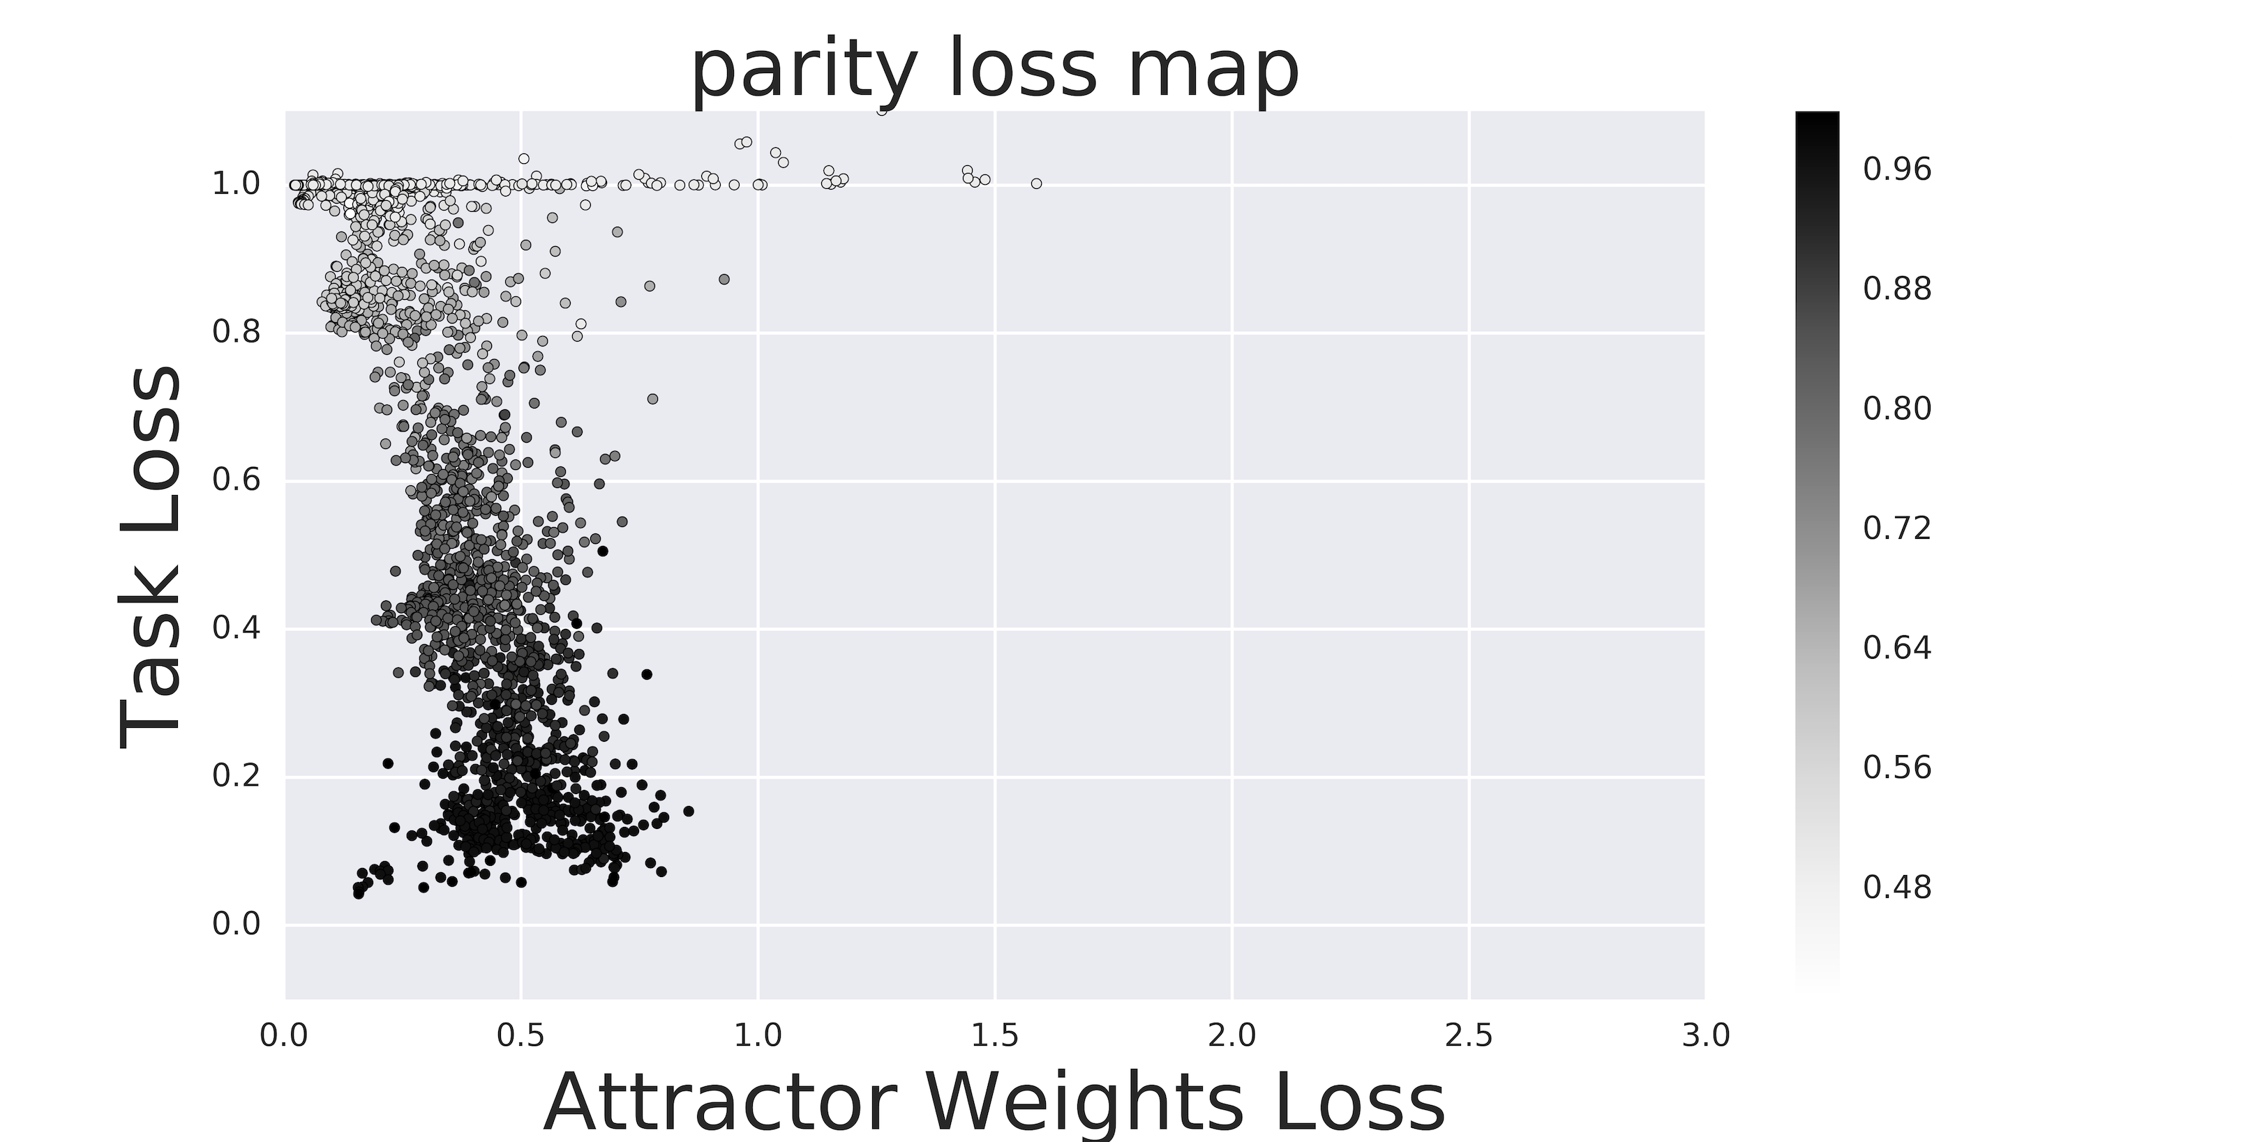
Bernoulli noise vs Gaussian
(2018-02-20)[Model<GRU>(attractor<projection,hid(5),h_hid(5)>, noise<0.2>, n_iterations<5>), Problem<parity>][epochs<5000>, repetitions<30>]__[MIKES CODE],solved[20of30] GAUSSIAN NOISE
(2018-02-20)[Model<GRU>(attractor<projection,hid(5),h_hid(5)>, noise<-0.2>, n_iterations<5>), Problem<parity>][epochs<5000>, repetitions<30>]__[MIKES CODE],solved[22of30] BERNOULLI NOISE
Qualitatively, the behavior seems similar, but quantitatively they are different.

Slide 11
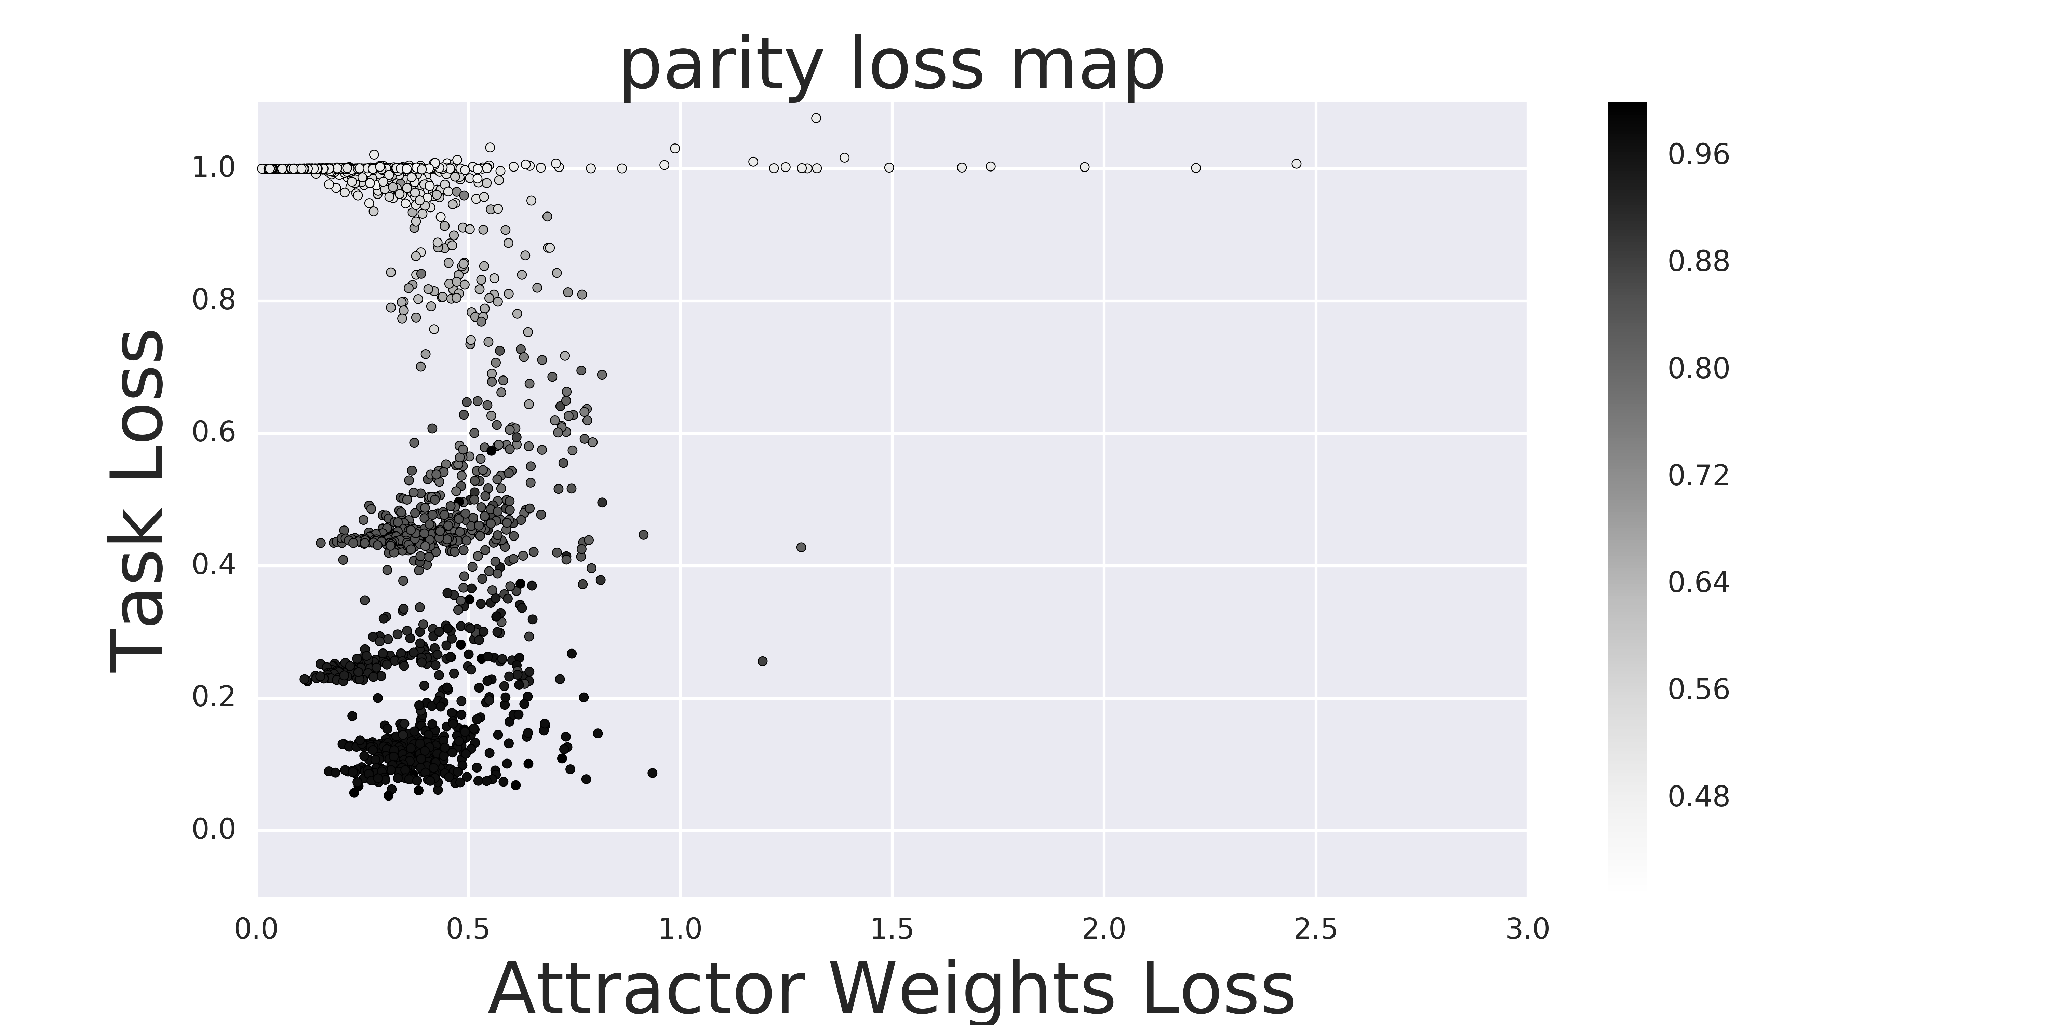
Not sure how to explain, but interesting. Same attractor loss, but failed to converge due to communication?)
(2018-02-20)[Model<GRU>(attractor<projection,hid(5),h_hid(20)>, noise<0.2>, n_iterations<5>), Problem<parity>][epochs<5000>, repetitions<30>]__[MIKES CODE],solved[16of30]
QUESTION: Reduced the noise pretty well, but I guess 20 hidden-hidden neurons is too much freedom, so it ???

Slide 13
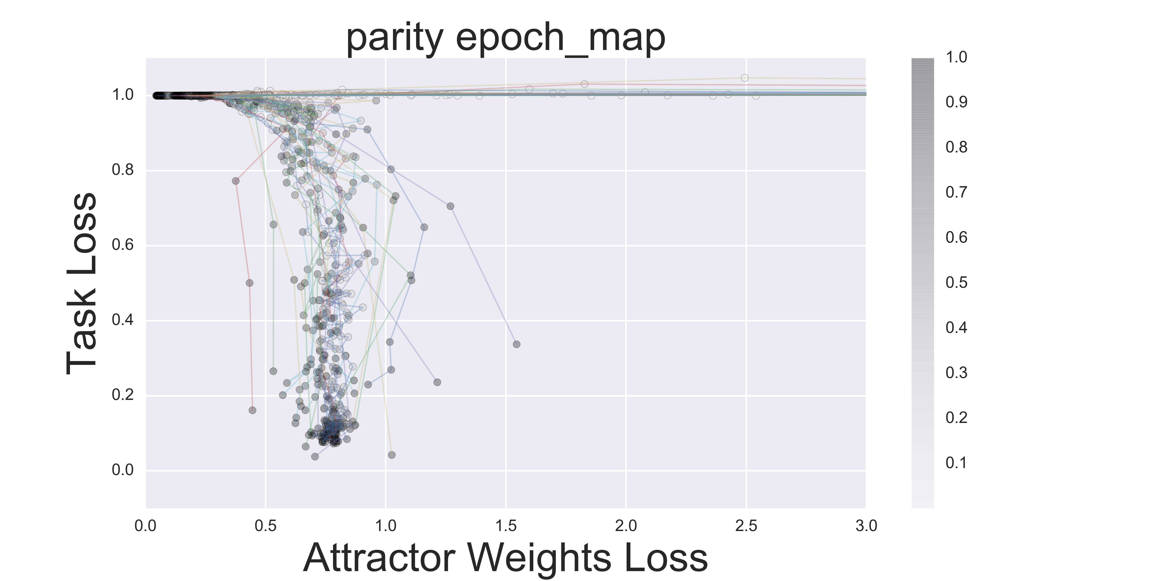
Once it goes too left, it never recovers. Like there is an actual barrier there.
Most trajectories steer too far left until the communication channel is established and then the task loss decreases, attractor loss increases. That theory is confirmed from observing that “As it trains task loss without updating attractor, attractor loss is slowly becoming worse (communication channel decays more and more)”
(2018-03-01)[Model<GRU>(attractor<direct,hid(5),h_hid(5),input_noise(0.1)>, noise<0.2>, n_iterations<5>), Problem<parity>][epochs<5000>, repetitions<30>]__progress_over_epoch

Slide 14


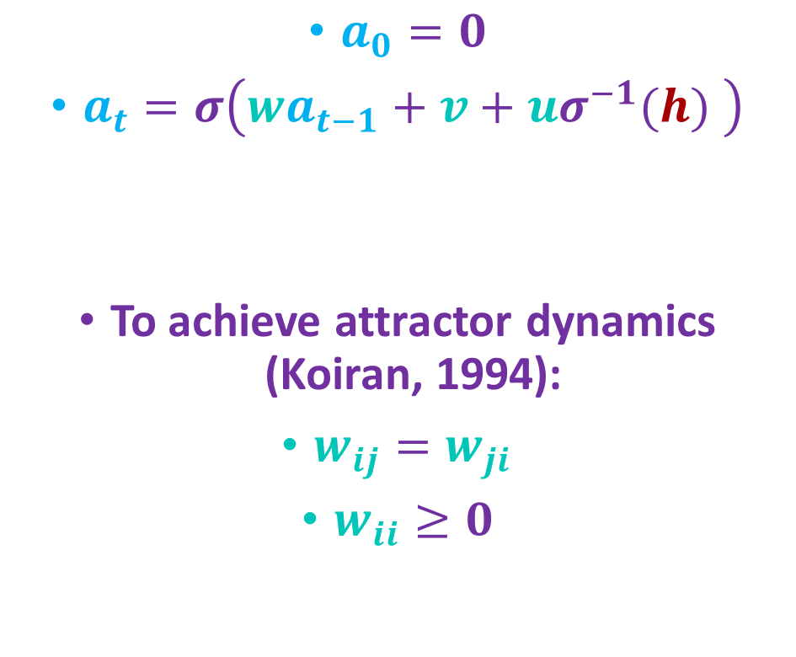
Attractor Net
$a_{0}=0$
$a_{t}=σ\left(wa_{t−1}+v+{uσ}^{−1}(h) \right)$
To achieve attractor dynamics (Koiran, 1994):
$w_{ij}=w_{ji}$
$w_{ii}≥0$
$$a$$
model parameters
$$h$$

Slide 15
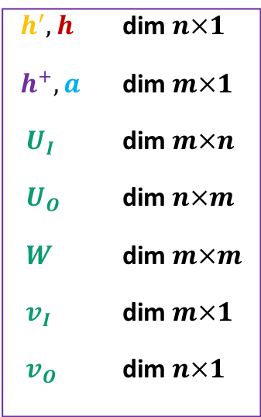



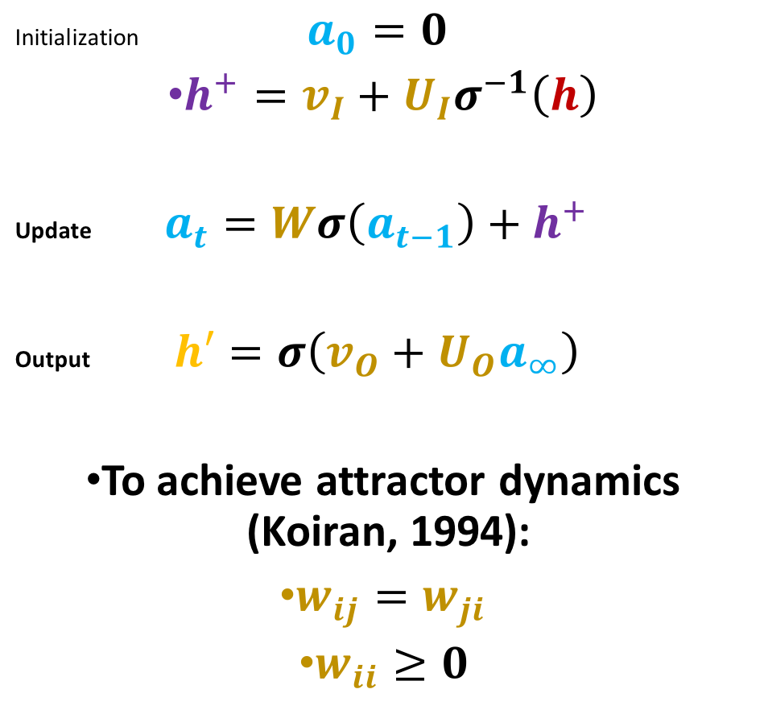
Attractor Net II
$$h′$$
Initialization $a_{0}=0$
$h^{+}=v_{I}+{U_{I}σ}^{−1}\left(h\right)$
Update $a_{t}=Wσ\left(a_{t−1}\right)+h^{+}$
Output $h′=σ\left(v_{O}+U_{O}a_{∞}\right)$
To achieve attractor dynamics (Koiran, 1994):
$w_{ij}=w_{ji}$
$w_{ii}≥0$
$h^{′},h$ dim $n×1$
${ h}^{+}, a$ dim $m×1$
$U_{I}$ dim $m×n$
$U_{O}$ dim $n×m$
$W$ dim $m×m$
$v_{I}$ dim $m×1$
$v_{O}$ dim $n×1$
$$a$$
$$h$$

Slide 16
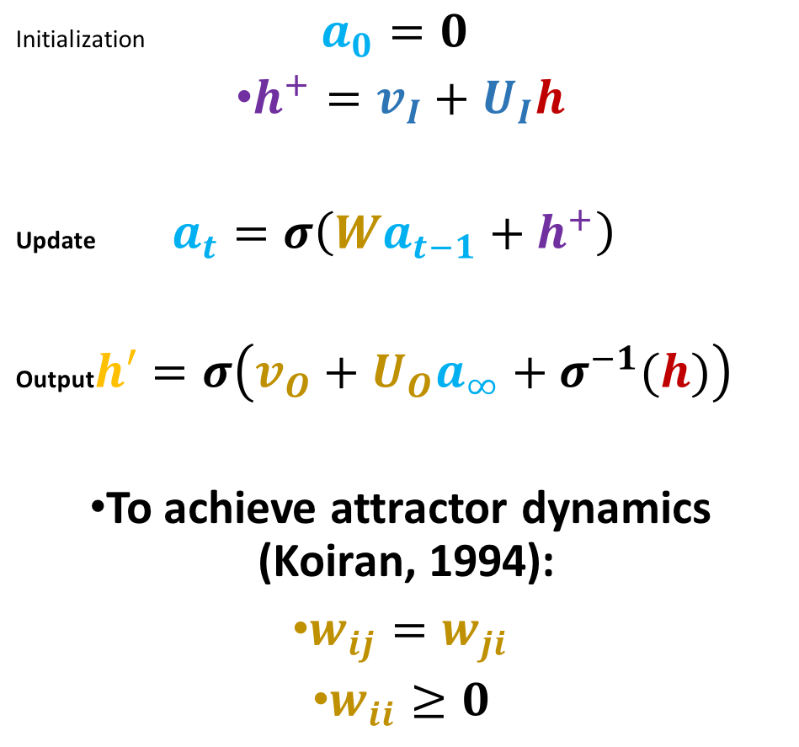
Attractor Net III
$$h′$$
Initialization $a_{0}=0$
$h^{+}=v_{I}+U_{I}h$
Update $a_{t}=σ\left({Wa}_{t−1}+h^{+}\right)$
Output $h′=σ\left(v_{O}+U_{O}a_{∞}+σ^{−1}(h)\right)$
To achieve attractor dynamics (Koiran, 1994):
$w_{ij}=w_{ji}$
$w_{ii}≥0$
$h^{′},h$ dim $n×1$
${ h}^{+}, a$ dim $m×1$
$U_{I}$ dim $m×n$
$U_{O}$ dim $n×m$
$W$ dim $m×m$
$v_{I}$ dim $m×1$
$v_{O}$ dim $n×1$
$$a$$
$$h$$

